Slide 1
DRAMATIZE IT! eTwinning Project CONFLICT MANAGEMENT SURVEY FINDINGS

Slide 2
DRAMATIZE IT! eTwinning Project A TOTAL OF 91 VOLUNTEER STUDENTS TOOK THE SURVEY.

Slide 3
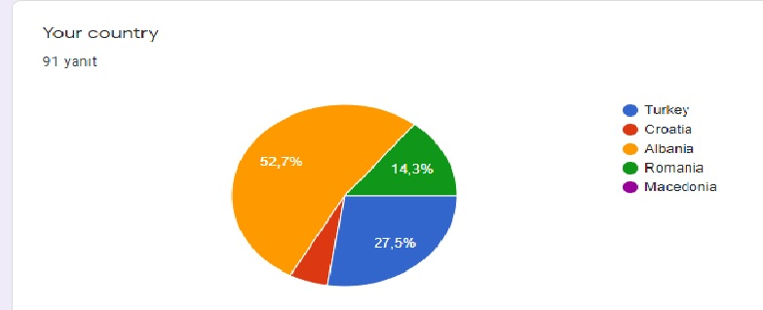
DRAMATIZE IT! eTwinning Project

Slide 4
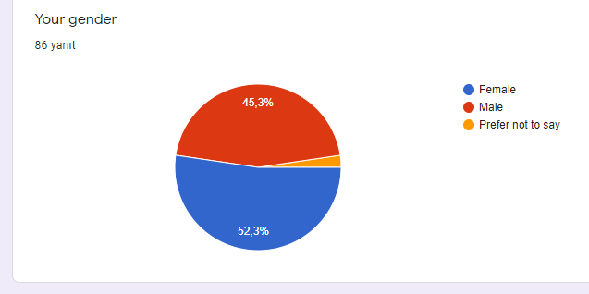
DRAMATIZE IT! eTwinning Project

Slide 5
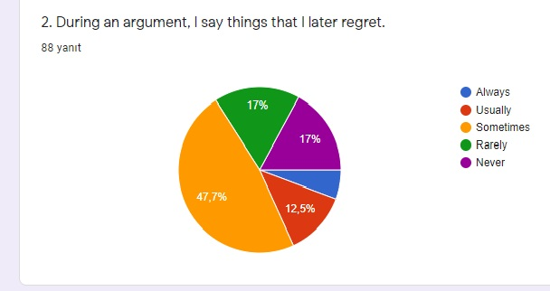
DRAMATIZE IT! eTwinning Project

Slide 6
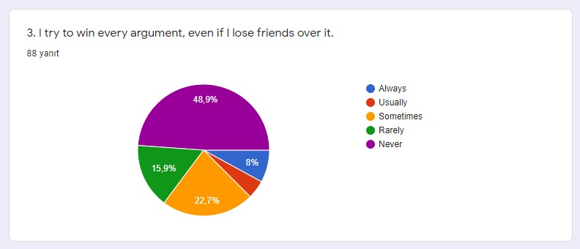
DRAMATIZE IT! eTwinning Project

Slide 7
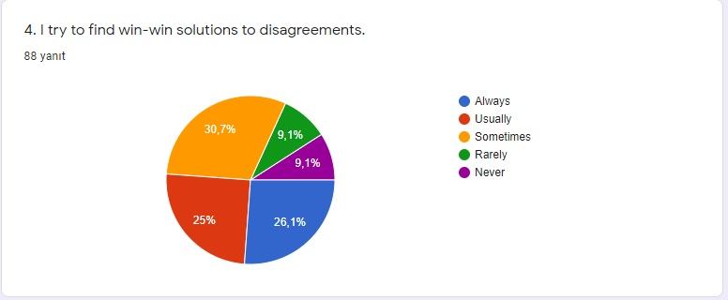
DRAMATIZE IT! eTwinning Project

Slide 8
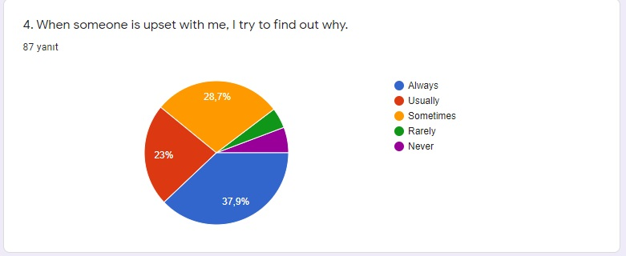
DRAMATIZE IT! eTwinning Project

Slide 9
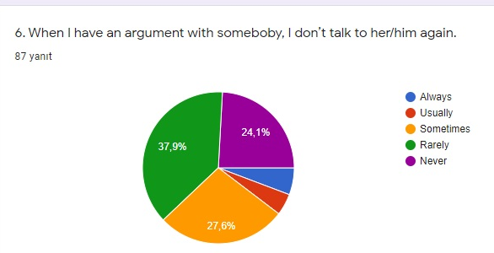
DRAMATIZE IT! eTwinning Project

Slide 10
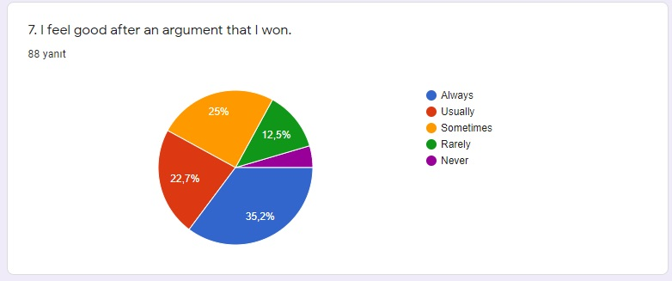
DRAMATIZE IT! eTwinning Project

Slide 11
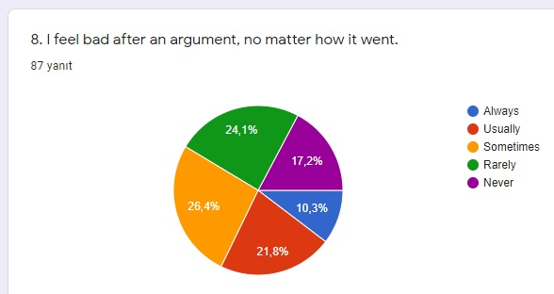
DRAMATIZE IT! eTwinning Project

Slide 12
DRAMATIZE IT! eTwinning Project
I mostly argue with my parents about…………..
Everything | Religion | Their mentality | Childhood
Nothing | Household Chores | Their health | Home management
About me | My lessons | Different opinions | Bed time
School | Spending time on the computer | My curfew | My behaviour towards others
Because they don’t understand me | TV because my parents watch very bad films | Spending time on social media | I don’t talk too much with my parents.
My private life | My life | Football | Tolerance
Family issues | Going out | Money issues

Slide 13
DRAMATIZE IT! eTwinning Project
I mostly argue with my siblings about…………..
My rights | Cleaning | Sharing the bedroom | The way of dressing
Nothing | Food | Everything | Life
Having different ideas | Sharing clothes | My phone | Books
Private subjects | Football | Music | My things
Little things | Movies | The school | Success
Because my brother is so messy | The time I turn back home | Our parents | I don’t talk to them too much
Playing games | Household chores |  | Where to drink coffee

Slide 14
DRAMATIZE IT! eTwinning Project
I mostly argue with my friends about…………..
School life | Stupid contradictions | Being irrational | New generation problems
Different opinions | Where to go | Projects | Lifestylies
Nothing | Telling lies | Hanging out | The way of entertaining
Other friends | Video games | Life | Movies
Homework | They don’t respect my ideas | Social issues | Success
Everything | Because I speak loudly | Fake things | I don’t have friends
If they don’t make me bad, I don’t argue. | School tasks and aswers | Punctuality

